Slide 1
What is Machine Learning?
A computer program is said to learn from experience E with respect to some task T and some performance measure P, if its performance on T, as measured by P, improves with experience E. Tom Mitchell, 1996

Slide 2
Machine Learning
Machine learning is an branch of artificial intelligence (AI) that provides systems the ability to automatically learn and improve from experience without being explicitly programmed. Machine learning focuses on the development of computer programs that can access data and use it learn for themselves.
The process of learning begins with observations or data, such as examples, direct experience, or instruction, in order to look for patterns in data and make better decisions in the future based on the examples that we provide. The primary aim is to allow the computers learn automatically without human intervention or assistance and adjust actions accordingly.

Slide 3
Types Of Machine Learning
Supervised machine learning.
Un-Supervised machine learning.
Semi-Supervised machine learning
Reinforcement machine learning

Slide 4
Supervised Machine Learning
Supervised learning is the machine learning task of learning a function that maps an input to an output based on example input-output pairs.
It infers a function from labeled training data consisting of a set of training examples.
In supervised learning, each example is a pair consisting of an input object (typically a vector) and a desired output value (also called the supervisory signal). A supervised learning algorithm analyzes the training data and produces an inferred function, which can be used for mapping new examples.

Slide 5
Types of Supervised Machine Learning Problems
Classification
A classification problem is when the output variable is a category, such as “red” or “blue” or “disease” and “no disease”.
Regression
A regression problem is when the output variable is a real value, such as “dollars” or “weight”

Slide 6
Supervised Machine Learning Algorithms
Some common types of problems built on top of classification and regression include recommendation and time series prediction respectively.
Some popular examples of supervised machine learning algorithms are:
Linear regression for regression problems.
Random forest for classification and regression problems.
Support vector machines for classification problems.
Decision Trees for Classification and Regression.

Slide 7
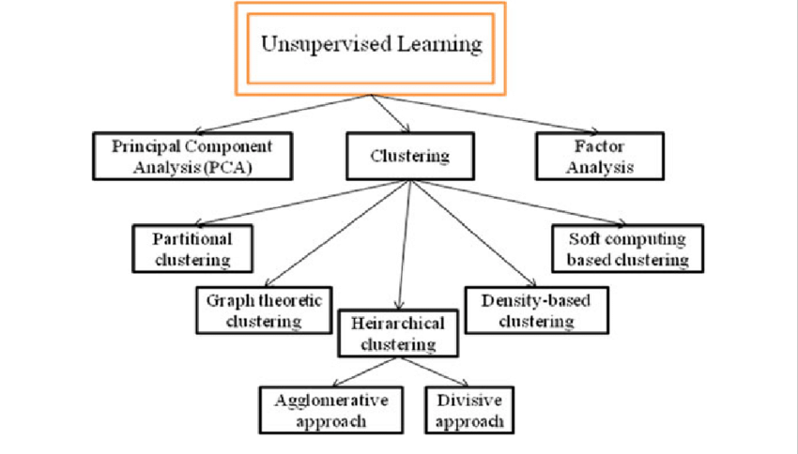
Un-Supervised Machine Learning Algorithms
Unsupervised learning is where you only have input data (X) and no corresponding output variables.The goal for unsupervised learning is to model the underlying structure or distribution in the data in order to learn more about the data.These are called unsupervised learning because unlike supervised learning above there is no correct answers and there is no teacher. Algorithms are left to their own devises to discover and present the interesting structure in the data.

Slide 8
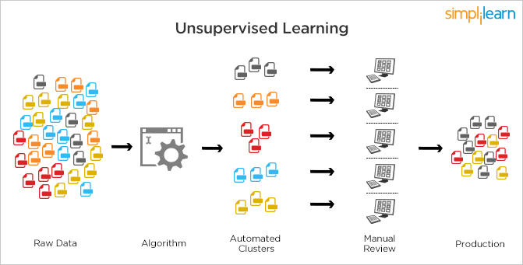
Un-Supervised Machine Learning Algorithms
Unsupervised learning problems can be further grouped into clustering and association problems.
Clustering: A clustering problem is where you want to discover the inherent groupings in the data, such as grouping customers by purchasing behavior.
Association: An association rule learning problem is where you want to discover rules that describe large portions of your data, such as people that buy X also tend to buy Y.
Some popular examples of unsupervised learning algorithms are:
PCA(Principal Component Analysis)
k-means for clustering problems.
Apriori algorithm for association rule learning problems.

Slide 9
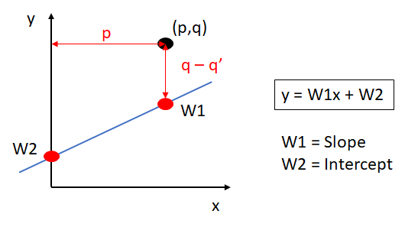
Supervised Machine Learning Algorithms
Linear Regression
Regression analysis is a subfield of supervised machine learning. It aims to model the relationship between a certain number of features and a continuous target variable.
In regression problems we try to come up with a quantitative answer, like predicting the prices of a house or the number of seconds that someone will spend watching a video.

Slide 10
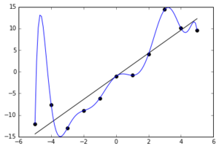
Supervised Machine Learning Algorithms
Linear Regression
Pros
Simple to Implement
Used to Predict Numerical Values
Cons
Prone to Overfitting
Cannot be used when reltion between independent and Dependent variables are non-linear

Slide 11
Supervised Machine Learning Algorithms
What is Random Forest?
Random forest is just an improvement over the top of the decision tree algorithm. The core idea behind Random Forest is to generate multiple small decision trees from random subsets of the data (hence the name “Random Forest”).
Each of the decision tree gives a biased classifier (as it only considers a subset of the data). They each capture different trends in the data. This ensemble of trees is like a team of experts each with a little knowledge over the overall subject but thourough in their area of expertise.
Now, in case of classification the majority vote is considered to classify a class. In analogy with experts, it is like asking the same multiple choice question to each expert and taking the answer as the one that most no. of experts vote as correct. In case of Regression, we can use the avg. of all trees as our prediction.In addition to this, we can also weight some more decisive trees high relative to others by testing on the validation data.

Slide 12
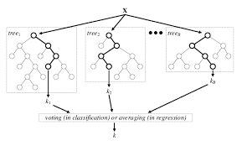
Supervised Machine Learning Algorithms
Random Forest
Random forests or random decision forests are an ensemble learning method for classification, regression and other tasks that operates by constructing a multitude of decision trees at training time and outputting the class that is the mode of the classes (classification) or mean prediction (regression) of the individual trees.

Slide 13
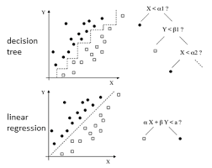
Supervised Machine Learning Algorithms
Random Forest
Pros:
One of the most accurate decision models.
Works well on large datasets.
Can be used to extract variable importance.
Do not require feature engineering (scaling and normalization)
Cons:
Overfitting in case of noisy data.
Unlike decision trees, results are difficult to interpret.
Hyperparamters needs good tuning for high accuracy.

Slide 14
Supervised Machine Learning Algorithms
Support Vector Machines
It is a Supervised Machine Learning algorithm which can be used for both Classification and Regression problems. The goal of SVM is to find the hyperplane which divides the Two Classes of data.
Generally, SVM is used to classify the data(supervised Learning). A hyperplane which divides two classes with Maximum distances is called as Optimal Hyperplane. Support Vector are those coordinates which are at minimum distance from the optimal hyperplane.
What if there is no line, that can separate two classes ?, It can also be used for Unsupervised Learning, When there is no line separating the classes, even if the data can't be separated in a linear way. SVM uses the kernel parameter. The idea is that if the data is viewed from a Higher Dimension then we can easily separate the Data with a 2D Plane.

Slide 15
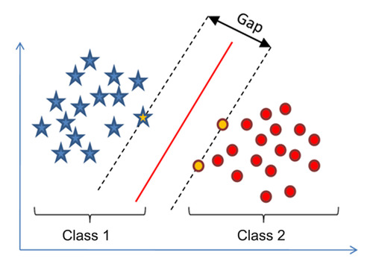
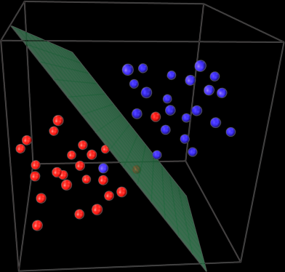
Supervised Machine Learning Algorithms
Support Vector Machines
Classification of Vectors
Vectors Under Higher Dimensional Space

Slide 16
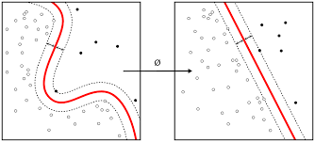
Supervised Machine Learning Algorithms
Pros and Cons of SVM
Pros
It's is effective in High Dimensional Spaces
It works really well with clear margin of separation
It is also effective in cases where number of dimensions is greater than number of samples.
Cons
It does not perform well, when we have a large data set.
Low performance, if the data set is noisy.

Slide 17
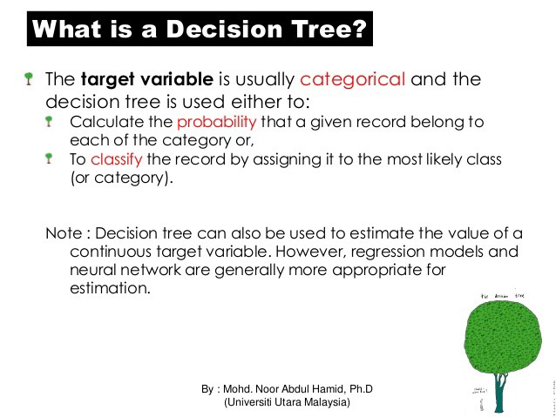
Supervised Machine Learning Algorithms
Decision Trees
A decision tree is a decision support tool that uses a tree-like graph or model of decisions and their possible consequences, including chance event outcomes, resource costs, and utility. It is one way to display an algorithm that only contains conditional control statements.

Slide 18
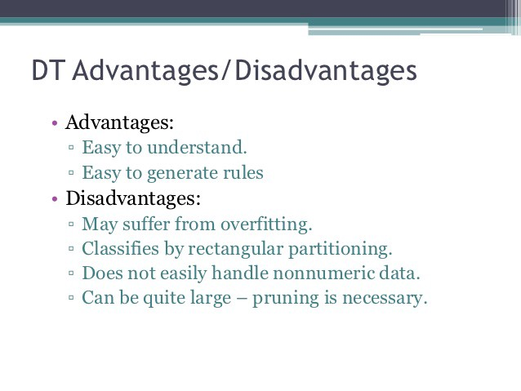
Supervised Machine Learning Algorithms
Pros and Cons of Decision Trees:
Pros
Simple to understand and Interpret
Requires little data preparation
Cons
Prone to over-fitting.
Decision trees can be unstable.

Slide 19
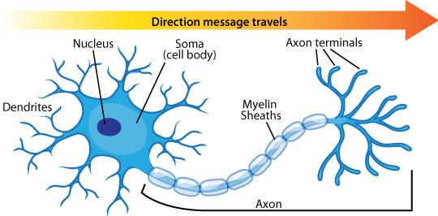
Neural Networks
How do humans actually Learn?

Slide 20
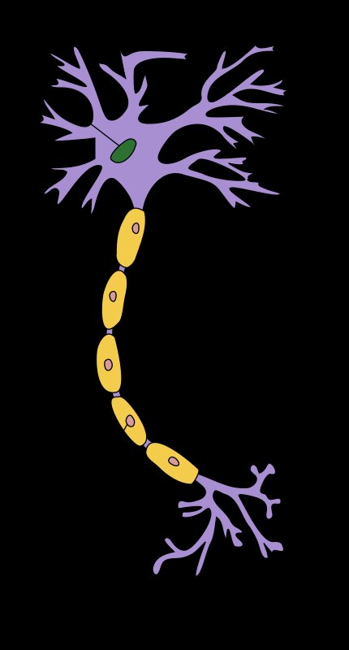
Dendrite
Dendrite or Dendrons, are branched protoplasmic extensions of a nerve cell that propagate the electrochemical stimulation received from other neural cells to the cell body, or soma, of the neuron from which the dendrites project. Electrical stimulation is transmitted onto dendrites by upstream neurons (usually their axons) via synapses which are located at various points throughout the dendritic tree. Dendrites play a critical role in integrating these synaptic inputs and in determining the extent to which action potentials are produced by the neuron.

Slide 21
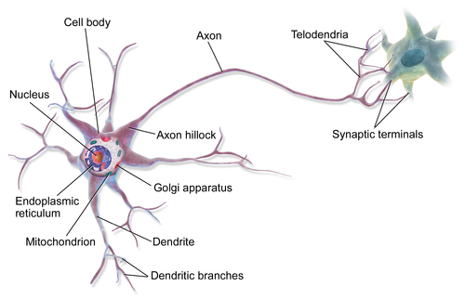
Axon
r nerve fiber, is a long, slender projection of a nerve cell, or neuron, in vertebrates, that typically conducts electrical impulses known as action potentials away from the nerve cell body. The function of the axon is to transmit information to different neurons, muscles, and glands. In certain sensory neurons (pseudounipolar neurons), such as those for touch and warmth, the axons are called afferent nerve fibers and the electrical impulse travels along these from the periphery to the cell body, and from the cell body to the spinal cord along another branch of the same axon.

Slide 22
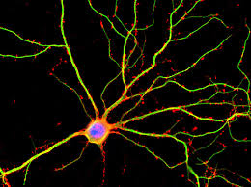
Neuron
A neuron (also called neurone or nerve cell) is a cell that carries electrical impulses. Neurons are the basic units of the nervous system. Every neuron is made of a cell body (also called a soma), dendrites and an axon. Dendrites and axons are nerve fibres.

Slide 23
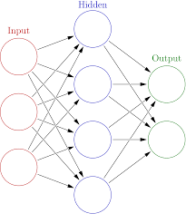
Artificial Neural Network
Artificial neural networks (ANN) or connectionist systems are computing systems inspired by the biological neural networks that constitute brains
A Biological Neural Ne-twork is A neural circuit which is a population of neurons interconnected by synapses to carry out a specific function when activated. Neural circuits interconnect to one another to form large scale brain networks. Biological neural networks have inspired the design of artificial neural networks.

Slide 24
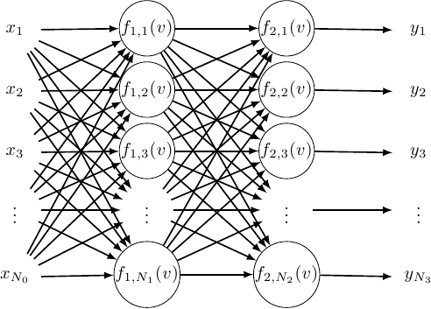
Back Propagation
Backpropagation is a method used in artificial neural networks to calculate a gradient that is needed in the calculation of the weights to be used in the network.
Backpropagation is shorthand for "the backward propagation of errors," since an error is computed at the output and distributed backwards throughout the network’s layers. It is commonly used to train deep neural networks.

Slide 25
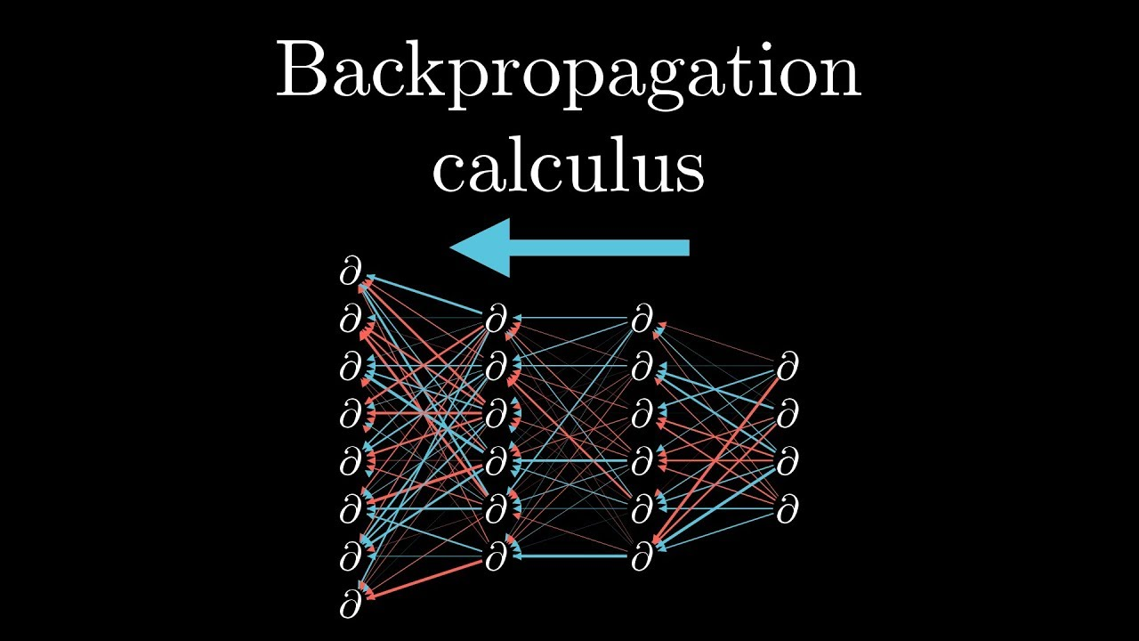
Back-Propagation
Backpropagation is a generalization of the delta rule to multi-layered feedforward networks, made possible by using the chain rule to iteratively compute gradients for each layer. It is closely related to the Gauss–Newton algorithm and is part of continuing research in neural backpropagation.

Slide 26
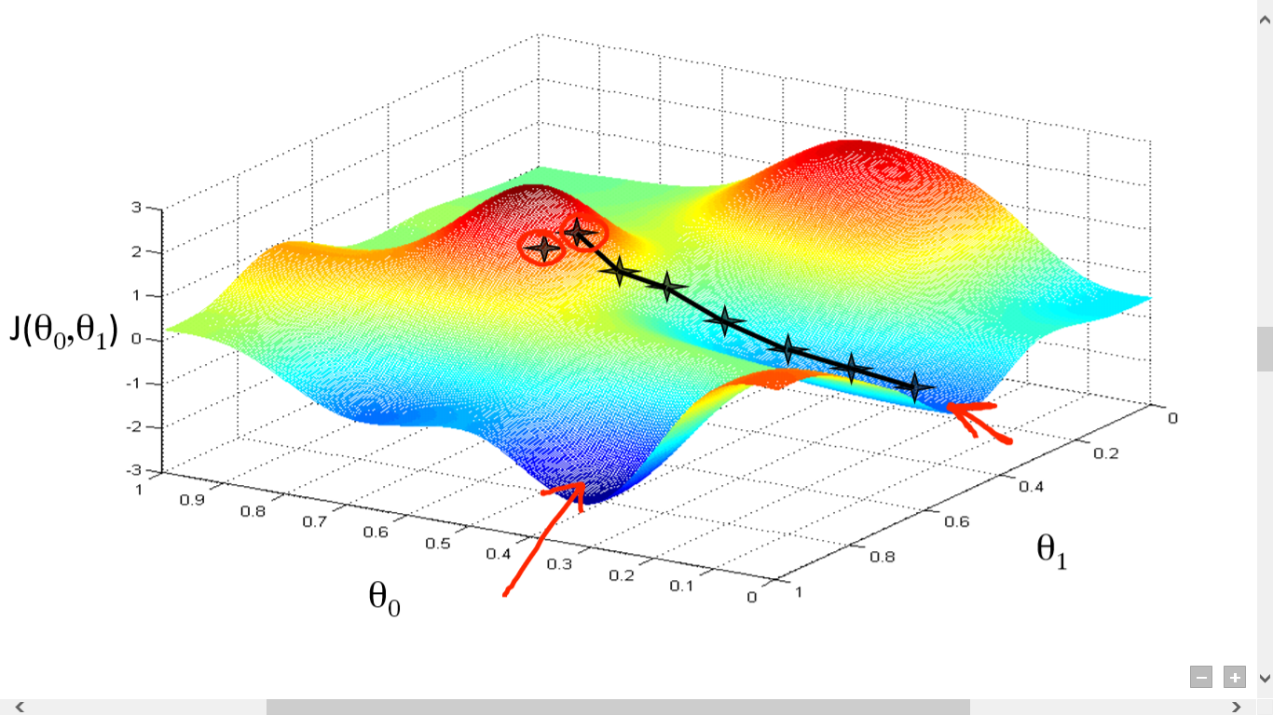
Gradient Descent
Gradient descent is a first-order iterative optimization algorithm for finding the minimum of a function. To find a local minimum of a function using gradient descent, one takes steps proportional to the negative of the gradient (or approximate gradient) of the function at the current point.

Slide 27

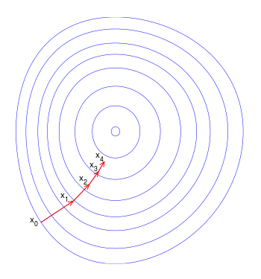
Hill Descent
Notes:
The basic intuition behind gradient descent can be illustrated by a hypothetical scenario. A person is stuck in the mountains and is trying to get down (i.e. trying to find the global minimum). There is heavy fog such that visibility is extremely low. Therefore, the path down the mountain is not visible, so they must use local information to find the minimum. They can use the method of gradient descent, which involves looking at the steepness of the hill at their current position, then proceeding in the direction with the steepest descent (i.e. downhill). If they were trying to find the top of the mountain (i.e. the maximum), then they would proceed in the direction of steepest ascent (i.e. uphill). Using this method, they would eventually find their way down the mountain or possibly get stuck in some hole (i.e. local minimum), like a mountain lake. However, assume also that the steepness of the hill is not immediately obvious with simple observation, but rather it requires a sophisticated instrument to measure, which the person happens to have at the moment. It takes quite some time to measure the steepness of the hill with the instrument, thus they should minimize their use of the instrument if they wanted to get down the mountain before sunset. The difficulty then is choosing the frequency at which they should measure the steepness of the hill so not to go off track.

Slide 28
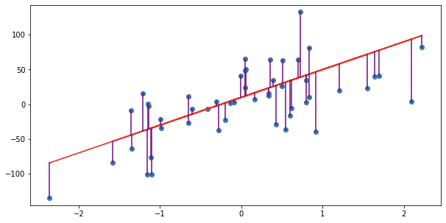
Linear Regression
Linear regression is a statistical approach for modelling relationship between a dependent variable with a given set of independent variables.
A linear model attempts to model to find the simplest relationship between the feature and Variable and Output as possible.

Slide 29
Outline
Introduction and Description
Some Potential Problems and Solutions
Writing Up the Results

Slide 30
Introduction and Description
Why use logistic regression?
Estimation by maximum likelihood
Interpreting coefficients
Hypothesis testing
Evaluating the performance of the model

Slide 31
Why use logistic regression?
There are many important research topics for which the dependent variable is "limited."
For example: voting, morbidity or mortality, and participation data is not continuous or distributed normally.
Binary logistic regression is a type of regression analysis where the dependent variable is a dummy variable: coded 0 (did not vote) or 1(did vote)

Slide 32
The Linear Probability Model
In the OLS regression:
Y = γ + ϕX + e ; where Y = (0, 1)
The error terms are heteroskedastic
e is not normally distributed because Y takes on only two values
The predicted probabilities can be greater than 1 or less than 0

Slide 33
An Example: Hurricane Evacuations
Q: EVAC
Did you evacuate your home to go someplace safer before Hurricane Dennis (Floyd) hit?
1 YES
2 NO
3 DON'T KNOW
4 REFUSED

Slide 34
The Data

Slide 35
OLS Results

Slide 36
Problems:
Predicted Values outside the 0,1 range
Descriptive Statistics
Std.
N
Minimum
Maximum
Mean
Deviation
Unstandardized
1070
-.08498
.76027
.2429907
.1632534
Predicted Value
Valid N (listwise)
1070

Slide 37
Heteroskedasticity
Park Test

Slide 38
The Logistic Regression Model
The "logit" model solves these problems: ln[p/(1-p)] = α + βX + e
p is the probability that the event Y occurs, p(Y=1)
p/(1-p) is the "odds ratio"
ln[p/(1-p)] is the log odds ratio, or "logit"

Slide 39
More:
The logistic distribution constrains the estimated probabilities to lie between 0 and 1.
The estimated probability is: p = 1/[1 + exp(-α - β X)]
if you let α + β X =0, then p = .50
as α + β X gets really big, p approaches 1
as α + β X gets really small, p approaches 0

Slide 40
